Slide 1
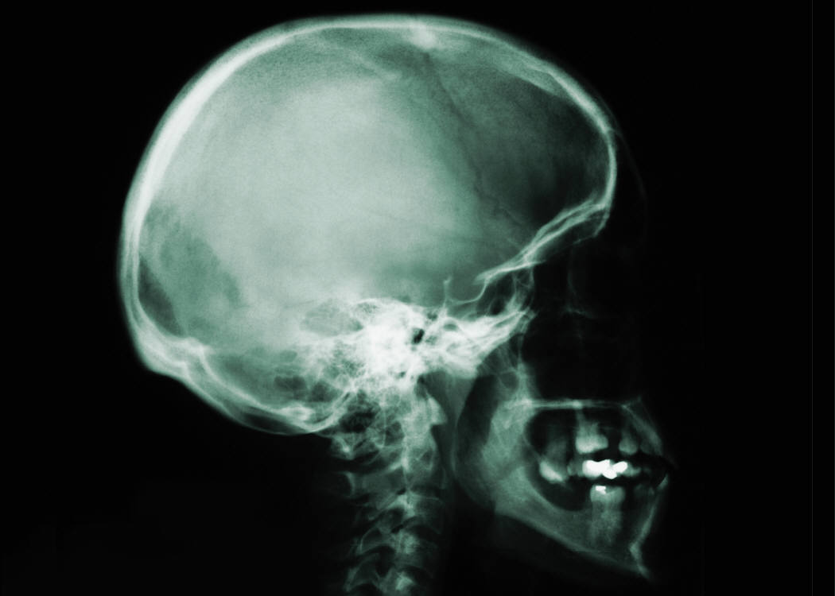
PTA Lab 1

Slide 2
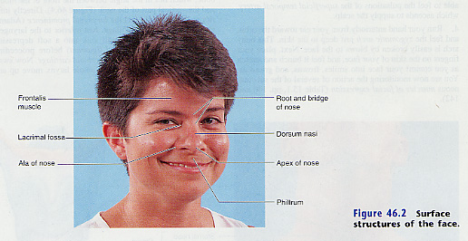
Head and Neck Surface Anatomy

Slide 3
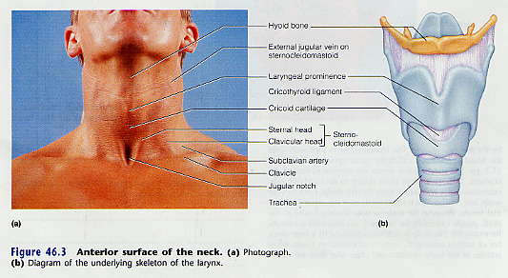
Surface Landmarks of the Neck

Slide 4
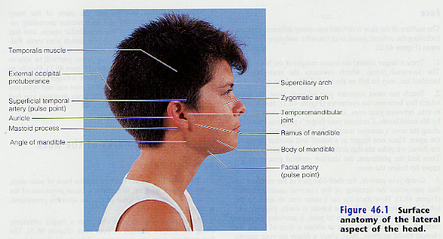
Surface Landmarks of the Lateral Surface of the Head

Slide 5
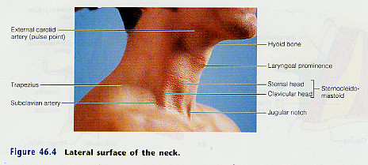
Surface Landmark Lateral Neck

Slide 6
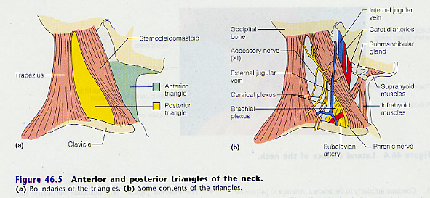
Deep Structures of the Lateral Neck

Slide 7
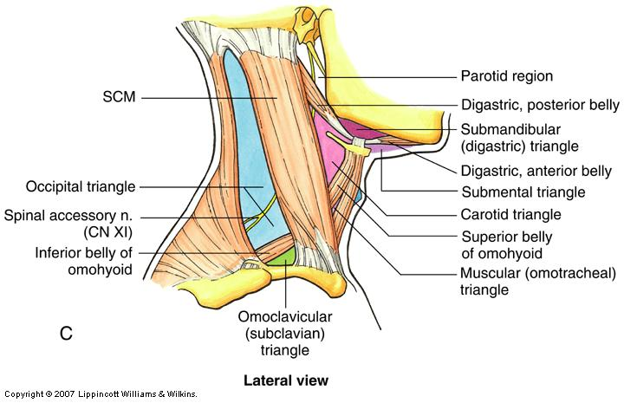
Deep Structures of the Lateral Neck

Slide 8
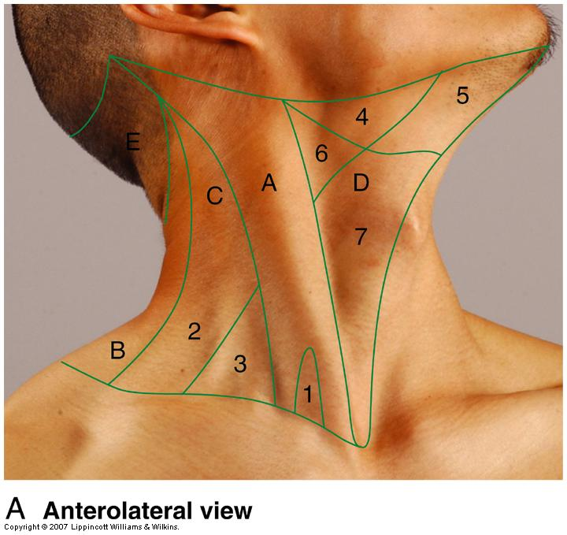
Structures of the Lateral Neck
Lesser Supraclavicular fossa
Occipital Triangle
Subclavian triangle
Submandibular triangle
Submental triangle
Carotid triangle
Muscular triangle
Sternocleidomastoid region
Posterior cervical region
Posterior triangle
Anterior triangle

